Slide 1

CST - 210
Stack and Heap
Memory allocation and some Garbage

Slide 2
In this lecture, we will discuss memory allocation in C++, but it is transferable to all compiled languages (kind of) Java and C# do memory just a little different.
Hopefully, after the lecture and some practices, you will get a better understanding of variable scope, garbage and garbage collection.
new and delete
*
&

Slide 3
Memory –
*If you have a good understanding of memory allocation, please offer any insight during the lecture. I believe that any open discussion during lectures are beneficial and some explanations are better understood in peer discussion.
This goes for all lectures moving forward. Programming is a celebrative environment.
Teams build applications.

Slide 4
Dynamic- Free memory
Local variables and functions
Global variables – static methods
Heap
Stack
Global(Static) - Shared
Program code.
allocated during runtime
decided during compile time
Size set by OS 1 to 2mb as a lose rule.
allocated during compile time

Slide 5
This is a desperate attempt to fix some things that I did wrong while teaching computer programming early in my career. A mea culpa of sorts.
When you learned about variables as a new programmer, you might have been taught something like, “they are containers for a data type”, or “as a name that refers to a location in the computer's memory.” those are good explanations of a variable right?
int x = 5; → type – name – assignment – value. Simple enough.
We know the program will make a space for an integer put 5 in it and give it a name called x. Now we can find 5 by using x.
(What is wrong with this statement?)

Slide 6
Beginning programmers are not worried about knowing that the x in….
int x = 5; is an identifier that can be used to refer to the memory location where the variable is.
I can refer to an albums crate as c1 and assign 200 albums in it.
int c1 = 200;
Albums are only held there when I need to get an album or add an album, I go to the location of the c1. I refer to the actual crate (location) when call say c1.
c1 it the memory location and my albums are just being held there.
Simple enough, remedial concept.

Slide 7
The & operator also known as the address-of operator.
Remember pass by value and pass by reference? We used the & operator to pass by reference or pass by address-of.
If I gave you the location of my album crate, you would have a reference to its exact location we share those albums, not a copy of or a new crate of albums are created.
Here is some examples of coding with &.

Slide 8
int myVar = 5;
int &myReff = myVar;
cout << myVar << " Value" << endl;
cout << myReff << " reference value" <<endl;
myReff = 20;
cout << myVar << " Value of" << endl;
cout << myReff << " reference value" << endl;
cout << &myVar << " Memory Location" << endl;
cout << &myReff << " Memory Location" << endl;
5 Value
5 reference value
20 Value of
20 reference value
0x7ffcd341405c Memory Location
0x7ffcd341405c Memory Location
0x7ffcd341405c Memory Location
0x7ffcd341405c Memory Location
myVar
myReff
20
5
myReff =20
myVar will change to 20 also
myReff
myVar

Slide 9
What are some advantages of passing by reference?
Pick someone close to you (physically – not your best friend – they might not be here) and think of 2 reasons why passing by reference may be beneficial in a function or method call.
Also think of 1 reason why passing by reference may cause unwanted side effects.

Slide 10
*Pointers
Pointers → * ←
We make reference to variables address with the &. That is the location of the variable.
A pointer will point to the memory location.
firstVar and newRef
int* ptr;
int firstVar = 5;
int secondVar = 10;
ptr = &secondvar;
int& newRef = firstVar;
5
address
secondvar
*ptr = 10
ptr = address
10
When this pointer is created it returns the address to ptr.

Slide 11
A pointer is a variable whose value is the address of another variable.
How is a pointer used?
Like any variable, it must be declared first.
int* ptr;
Now the pointer variable called ptr can be used.

Slide 12
#include <iostream>
using namespace std;
int main() {
int myVar = 5; //just an int
int* ptr; //pointer variable *
ptr = &myVar; //reference to my var address
cout<< myVar<< " myVar" << endl;
cout << ptr << " ptr address" << endl;
cout << *ptr << " dereferenced ptr" << endl;
}
5 myVar
0x7ffe8c82915c ptr address
5 dereferenced ptr

Slide 13
Reference
A reference (&) is like an alias to an existing variable.
A reference (&) is like a constant pointer that is automatically dereferenced.
It is usually used for function argument lists and function return values.
A reference must be initialized when it is created.
Once a reference is initialized to an object, it cannot be changed to refer to another object.
You cannot have NULL references.
A const reference can refer to a const int. It is done with a temporary variable with value of the const
Pointers
A pointer is a variable that holds a memory address.
A pointer declaration consists of a base type, an *, and the variable name.
A pointer can point to any number of variables in lifetime
A pointer that does not currently point to a valid memory location is given the value null (Which is zero)

Slide 14
Pointers, arrays and array arithmetic. Accessing an array with pointers.
Array access using pointers is a little faster than subscript access.
When we passed an array into a function, it only passed the first pointer.
C++ The name of the array is actually a pointer to the first value of the array.
With an array, you don’t need to create a pointer to first element, the name is a pointer.
I will code an example using pointers and the array name.

Slide 15
int numbers[4] = {5,10,15,20}; //array numbers
for(int i = 0; i < 4; i++){
cout << numbers[i] << " "; //normal loop through array
}
int *arrayPtr = &numbers[0]; //assigning a pointer to 0 element
cout << endl << *arrayPtr << endl; //print dereferenced value
cout << *numbers << endl; //print dereferenced array value
for(int i = 0; i < 4; i++){
cout << *(numbers + i) << " "; //using array name as pointer
}
cout << endl;
for(int i = 0; i < 4; i++){
cout << *(arrayPtr + i) << " "; //starting at first pointer
}
5 10 15 20
5
5
5 10 15 20
5 10 15 20
When using pointers to loop through an array, the pointer takes precedence, and you are using the memory address not the index. *numbers + 1 = 6
*(numbers + 1) will move the pointer to the next memory cell and dereference it.
*(numbers + 1) = 10.

Slide 16
Dynamic- Free memory
Local variables and functions
Global variables – static methods
Heap
Stack
Global(Static) - Shared
Program code.
allocated during runtime
allocated during compile time
Size set by OS 1 to 2mb as a lose rule.
allocated during compile time

Slide 17
Stack and Heap
This is a small look at the stack and the heap.
I don’t know how much you know about the stack and heap, but it is an important part of efficient programming. In C++ there are templates that do a lot of the heavy lifting for you when writing, but at times, you will need to manage the memory from stack and heap natively.
Knowing what each one does is essential to understanding variable, object, and data structures both in scope and performance.

Slide 18
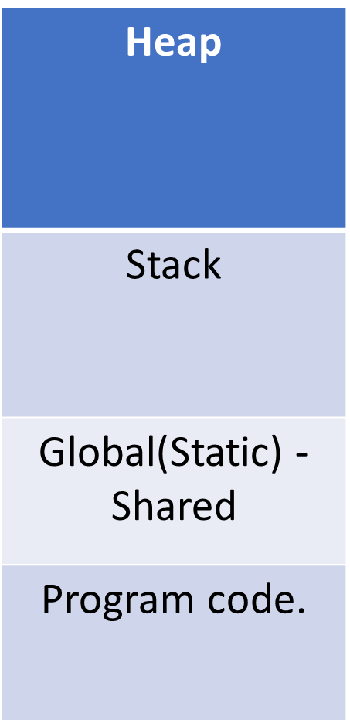
This is the RAM memory in a computer completely controlled by the operating system. It can be as many gigs as you can afford.
What is the difference between stack memory and heap memory?
Heap:
Large pool of operating system memory
Used in dynamic memory allocation
Uses “new” keyword in C++ to allocate memory on the heap.
Stack:
Set by the OS 1 to 2 mb.
Each process gets its own stack
LIFO (Last In First Out)
Continuous block of memory

Slide 19
How do we get to the stack?
The stack is fast and dynamically changing depending of the function on top of the stack.
When we call a function, the variables inside of it are allocated space on the stack. Once the function is finished, it is removed from the stack. C++ main is the starting gate.
STACK
int main() {
int x = 5;
}
5

Slide 20
STACK
void stuff(){
int x = 5;
int y = 10;
cout << x << " x in stuff()" << endl;
}
int main() {
int x = 5;
cout << x << " x in main()" << endl;
stuff();
}
5
10
5
Address 0003
Address 0002
Address 0001

Slide 21
As soon as the function is finished, the stack ‘pops’ the last allocated memory location and what is ever stored there. Those variables are not visible anymore, because the memory is no longer allocated for them. It is gone. This is the scope lifetime. Same thing happens in a for loop. for(int i = 0; i < 10 i ++). i scope is ended after the block.
If you write a recursive method, why would it cause a stack-overflow if there is no base case?
void stuff(){
int x = 5;
int y = 10;
cout << x << " x in stuff()" << endl;
}
int main() {
int x = 5;
cout << x << " x in main()" << endl;
stuff();
}
5
10
5

Slide 22
Heap – new – delete – garbage collection
Using templates in C++ is an efficient way to keep the heap managed.
There are times when you will need to create your own template, write custom classes, or need to allocate heap memory from a method.
When this is done, it is allocating memory away from the stack and can be used until it is no longer needed. Unlike stack where the stack is responsible for ‘stacking and popping’ allocated memory and the value inside of it, the programmer is responsible for “asking” for memory, and if it is not used, deleting it so we can avoid inefficiency and memory leeks. (Google Chrome or anything Ubisoft makes)

Slide 23
The keyword for allocating heap memory is new. Anyone that has done any OOP knows the keyword new.
new <type> //type can be any data type or new class
int *ptr = new int;
HEAP
Here is a simple allocation of heap memory.
New does some great things, one property of
new is that it has a return value of the address where it allocates memory.
With a pointer, we can hold that address!
Cool.
Memory address
?

Slide 24
int *ptr = new int;
*ptr = 5;
STACK
HEAP
Now pointer ptr is referring to that particular int out on the heap.
With a dereferenced *ptr we can assign value to it. The pointer gets us to the allocated heap space. It is assigned an int value of 5.
00001 memory address
ptr → 00001
5

Slide 25
int *ptr = new int;
*ptr = 5;
p = new int(20);
STACK
HEAP
Now pointer ptr is assigned a new address with a value of 20. The new operator RETURNS the new heap address.
ptr is now referencing that particular integer memory space on the heap with the value of 20.
Notice that address 00001 is still on the heap but nothing is accessing it.
This is now GARBAGE.
00003 memory address
20
00001 memory address
ptr → 00003
GARBAGE
5

Slide 26
int *ptr = new int;
*ptr = 5;
delete p;
p = new int(20);
STACK
HEAP
delete will not delete ptr, it will delete what ptr is pointing to.
ptr remains on the stack and until it is reassigned, it is a dangling pointer. It is still pointing to 00001 but it is not a valid location. It is pointing to free space that as no association to any type or value.
p = new int(20); will assign the pointer to 00003
00003 memory address
20
00001 memory address
ptr → 00003

Slide 27
Dangling pointers.
If you delete and do not reassign the pointer it is best practice to reassign that pointer to NULL or 0.
int *ptr = new int;
*ptr = 5;
delete p;
int *ptr = new int;
*ptr = 5;
delete ptr;
ptr = NULL; // ptr = 0;

Slide 28
This is a short introduction to stack and heap. Pointers, reference, and dereference will be come more comfortable as the class goes along.
It is my hope that we can explore more of this as the class goes along.
In OOP custom classes are essential to creating applications.
For fun, write two quick methods one that only accesses the stack and one that will create a variable on the heap.
Any questions on Lucky 7, or this week’s DQ?

Slide 29
Lets look at the assignments for this topic.
Lottery Picker
Encryption

